Slide 1

THE BIG LEVY INVESTMENTS
Fintech a.y. 2024/25
Politecnico di Milano
Group 13
Manfredi Giacomo, Pascotto Leonardo,
Tarditi Andrea, Toia Nicolò, Torba Matteo

Slide 2
TABLE OF CONTENTS
1. Aim of the project
2. Selection of Target Portfolios
3. Customer Classification
4. Replica Construction
5. Anomaly Detection
6. Recommender System
7. WebApp

Slide 3

AIM OF THE
PROJECT
This project integrates machine learning, portfolio replication and anomaly detection to deliver adaptive, personalized investment solutions - providing a robust tool that aligns portfolio allocations with shifting market conditions and each investor’s unique objectives.
Deliver a ready-to-use WebApp that empowers investors and advisors with:
Personalized portfolio suggestions via client classification (Income vs Accumulation)
Replica strategies that track key equity & bond benchmarks through futures-based models
Real-time anomaly detection to shift exposure during market stress
Cost-aware results by integrating all trading fees
Performance monitoring for transparent, risk-adjusted evaluation

Slide 4
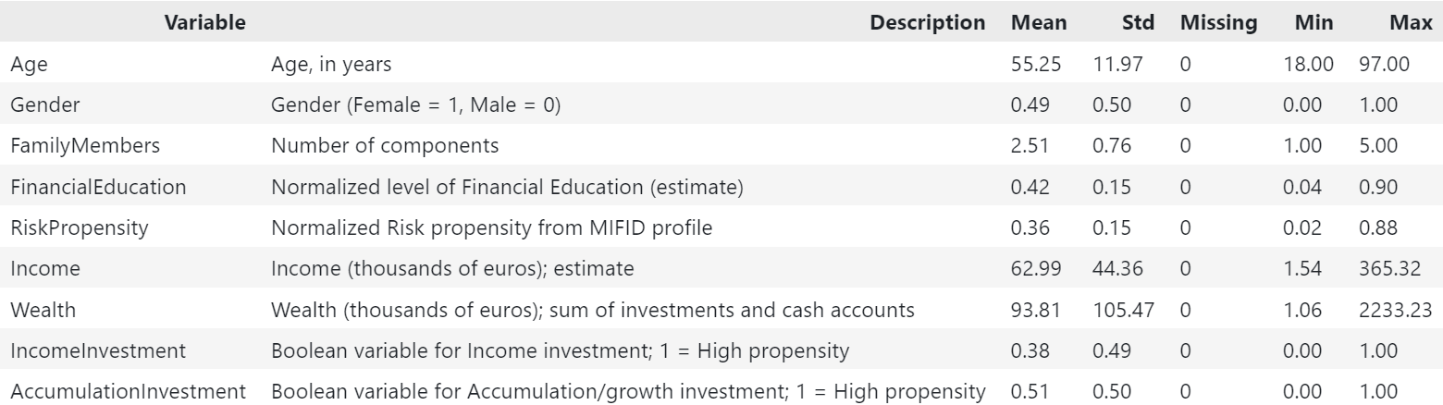
CUSTOMER CLASSIFICATION
Purpose & Scope
Core of the Recommender System
Supervised-learning pipeline that predicts two client investment needs: Accumulation Investment & Income Investment.
Why it matters
Provides fast, data-driven recommendations that plug directly into the advisory workflow.
Built for interpretability (business users) and flexibility (future model swaps).

Slide 5
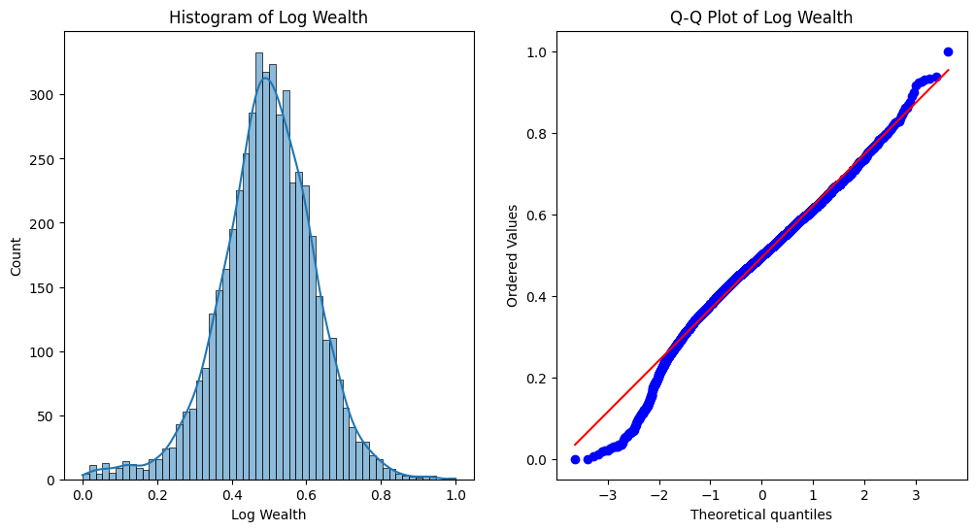
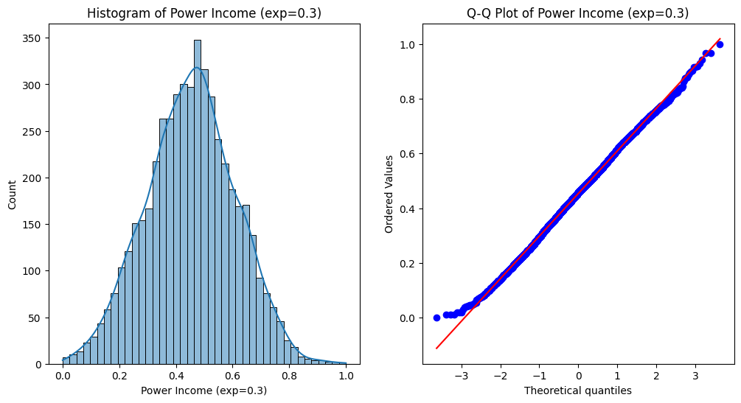
EDA
Input source: Excel workbook
Needs (client features + labels)
Products (product metadata)
Metadata (variable dictionary & summaries)
Transformations
Wealth → log(1 + x) | Income → power (0.3)
Min-Max scale: Age, FamilyMembers, RiskPropensity, transformed Income & Wealth
Exploratory checks
Class balance, feature distributions, correlation heat-map, box/violin & joint plots - ensuring solid ground before modeling.

Slide 6
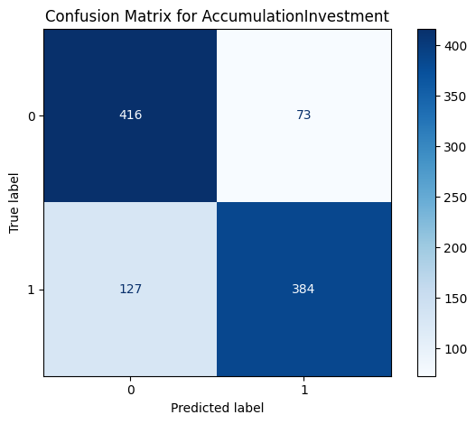
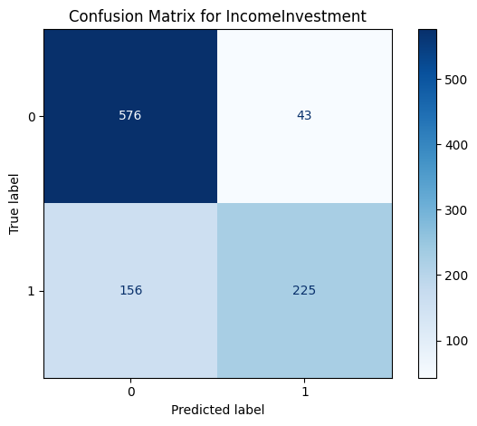
RESULTS
Modeling, Evaluation & Deliverables
Single-target & Joint-target Random-Forest models
Hyper-parameter search with Optuna
MultiOutputClassifier for overlapping needs
Custom evaluation
Standard metrics + penalty score reflecting asymmetric mis-classification costs.
Threshold (τ) tuning to maximize F1 / minimize penalty.
Outputs ready for production
Validation & test reports.
Real-time methods apply full pipeline in one call - scalable, modular, and deployment-ready.

Slide 7
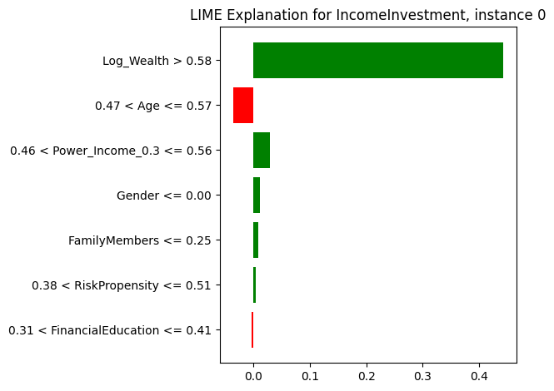
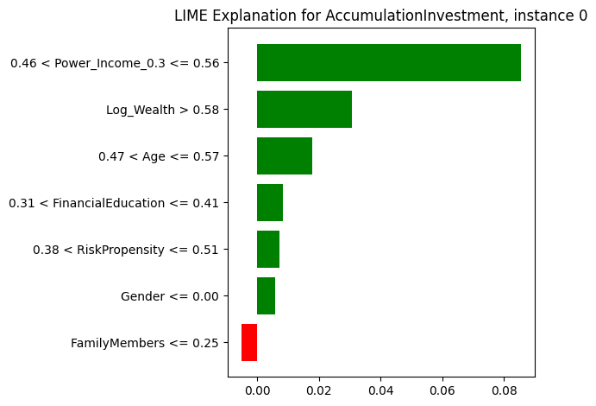
INTERPRETABILITY
A variety of feature-importance techniques was incorporated to clarify the drivers of the model’s predictions. In regulatory and production contexts, machine-learning systems must be able to explain the results they generate.
Accordingly, local interpretability methods were added to identify the key features influencing each individual observation.

Slide 8
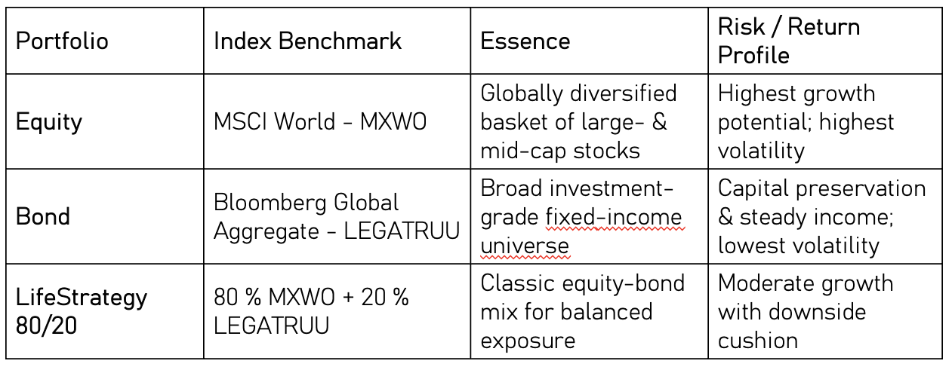
PORTFOLIO REPLICA
A universe of indices and futures was used, and—without insight into the target index’s composition—the models were tasked with replicating its return profile.
These three reference portfolios frame the study - spanning pure growth, pure defense, and a balanced middle ground - so the predictor, replica models, and risk controls can be evaluated across distinct market-risk spectrums.

Slide 9
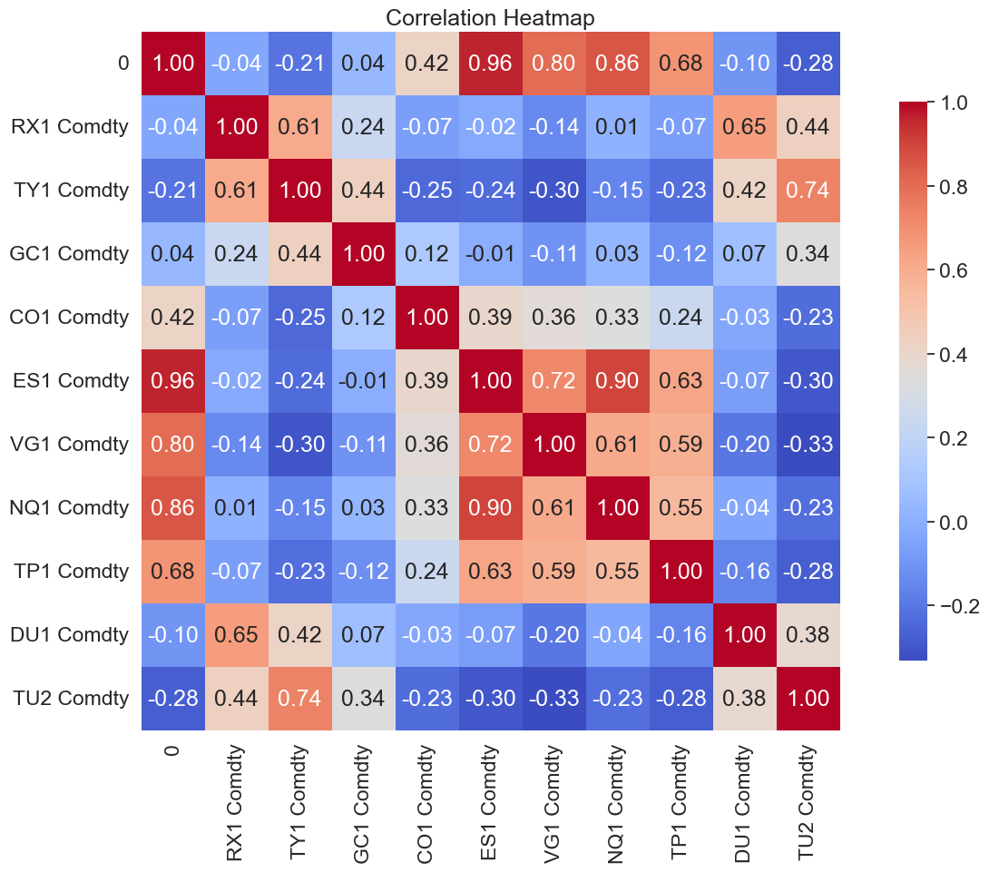
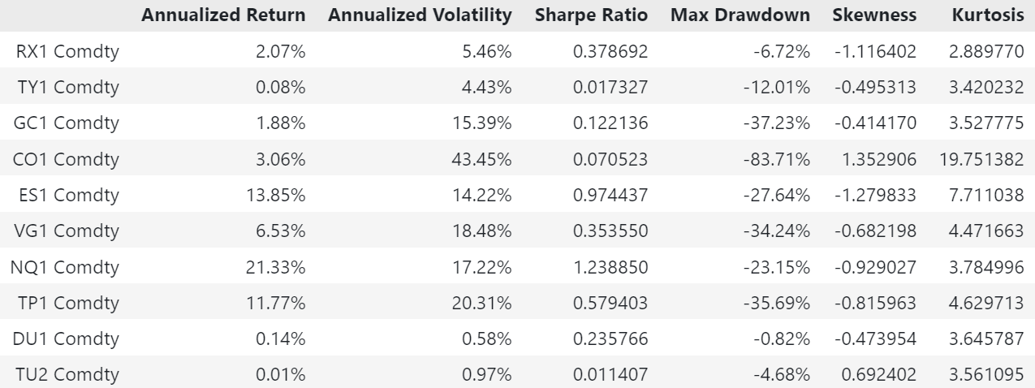
EDA AND CUSTOM COST STRATEGY
The dataset was first evaluated for Gaussianity and stationarity, and targeted transformations were applied where necessary. Cumulative returns and rolling-window correlations were subsequently computed to characterise the underlying dynamics.
Transaction costs were incorporated into each rebalancing period to ensure realistic performance estimates.
Transaction cost was calculated with a fixed transaction rate of 0.05%.

Slide 10
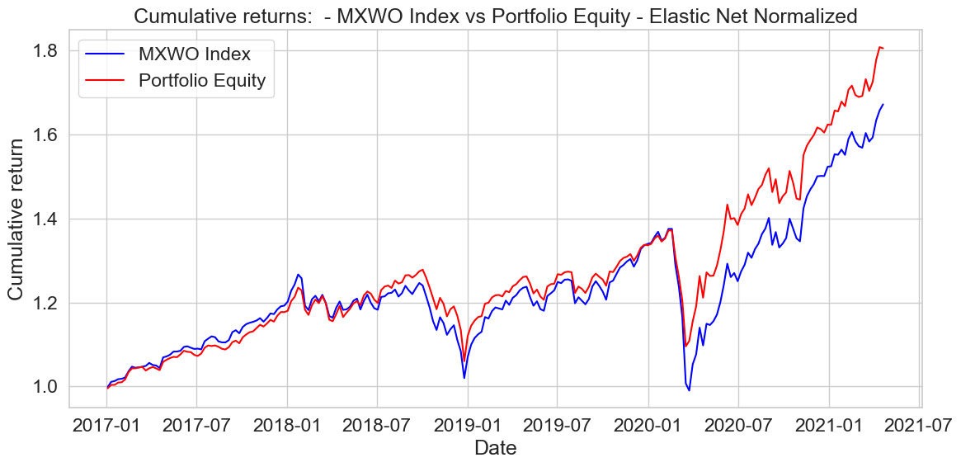
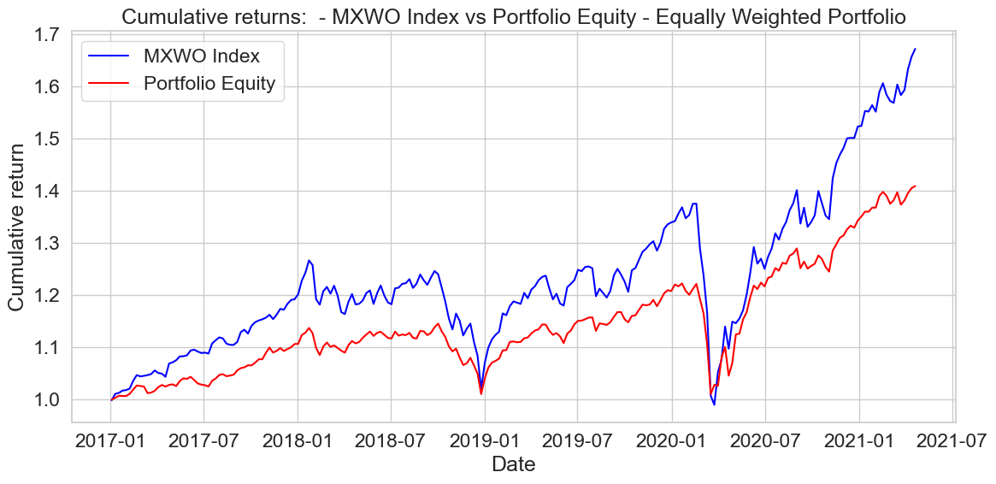
REPLICA PORTFOLIOS
This slide contrasts the Equally-Weighted portfolio—shown through cumulative returns only—with the Elastic Net replication.

Slide 11
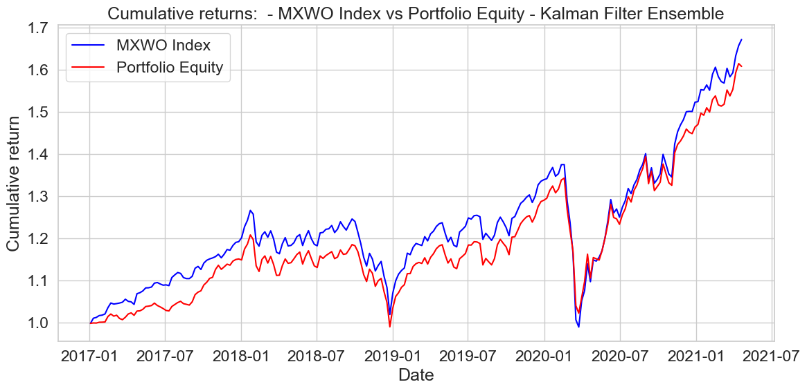
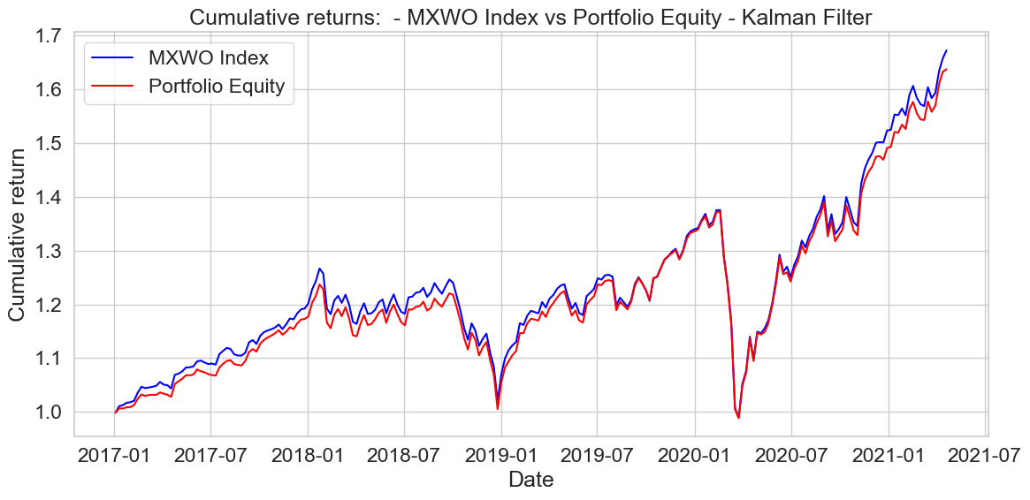
This slide contrasts the kalman Filter portfolio—shown through cumulative returns only—with the Ensemble Kalman Filter

Slide 12
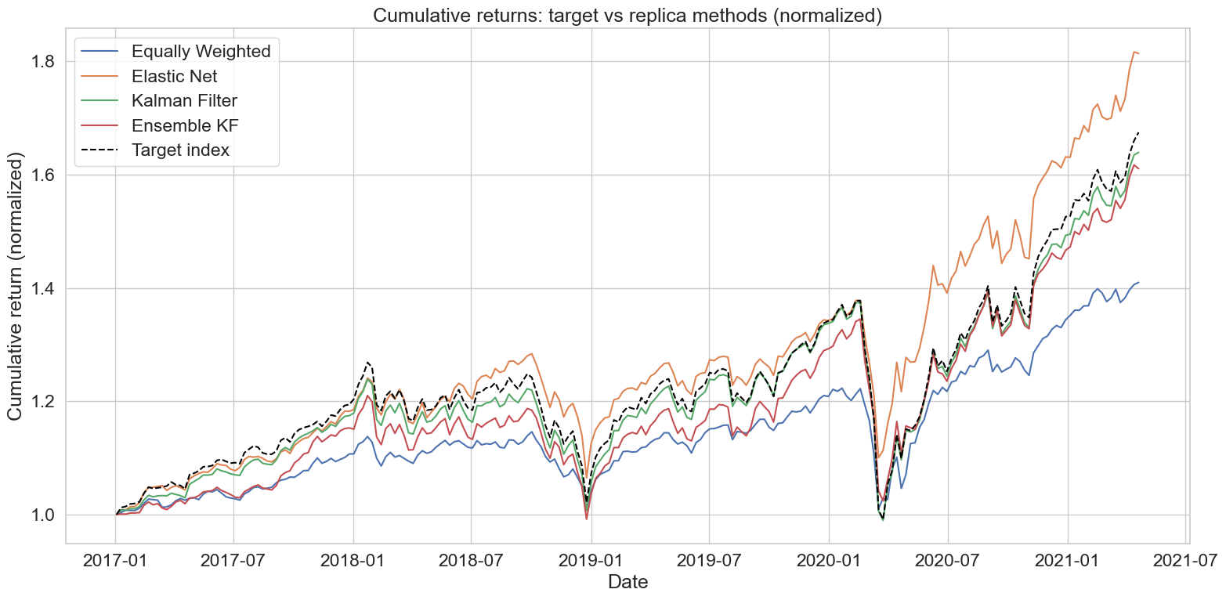
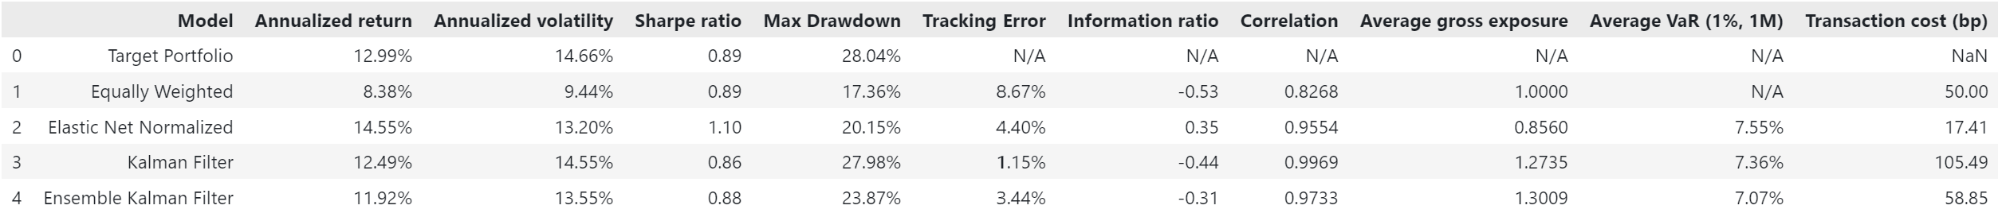

Slide 13
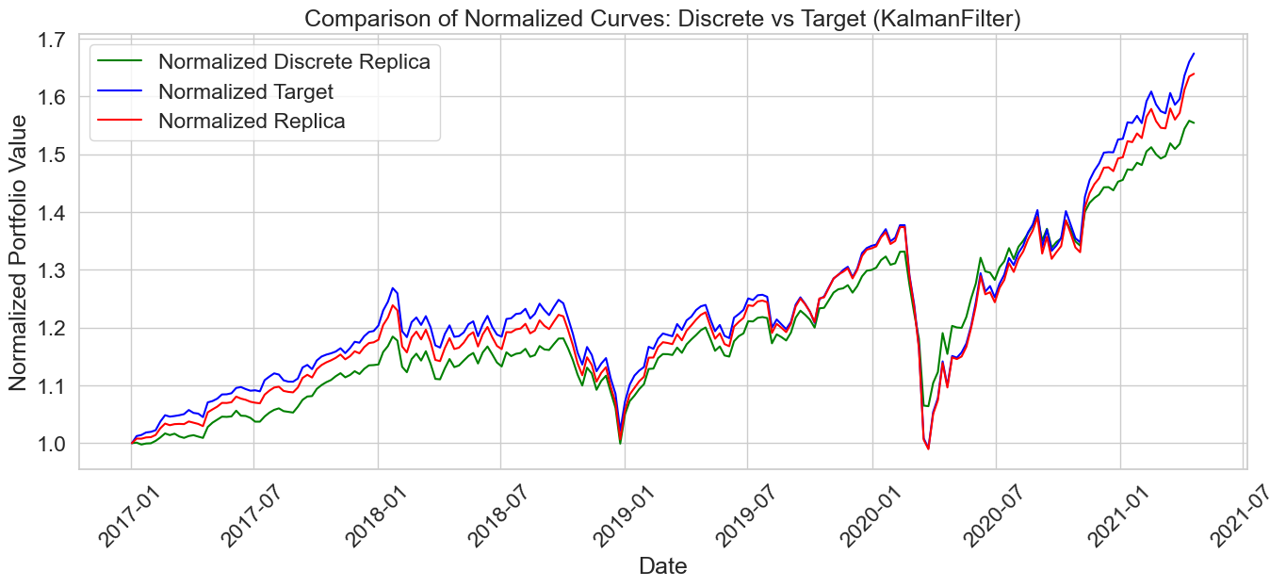
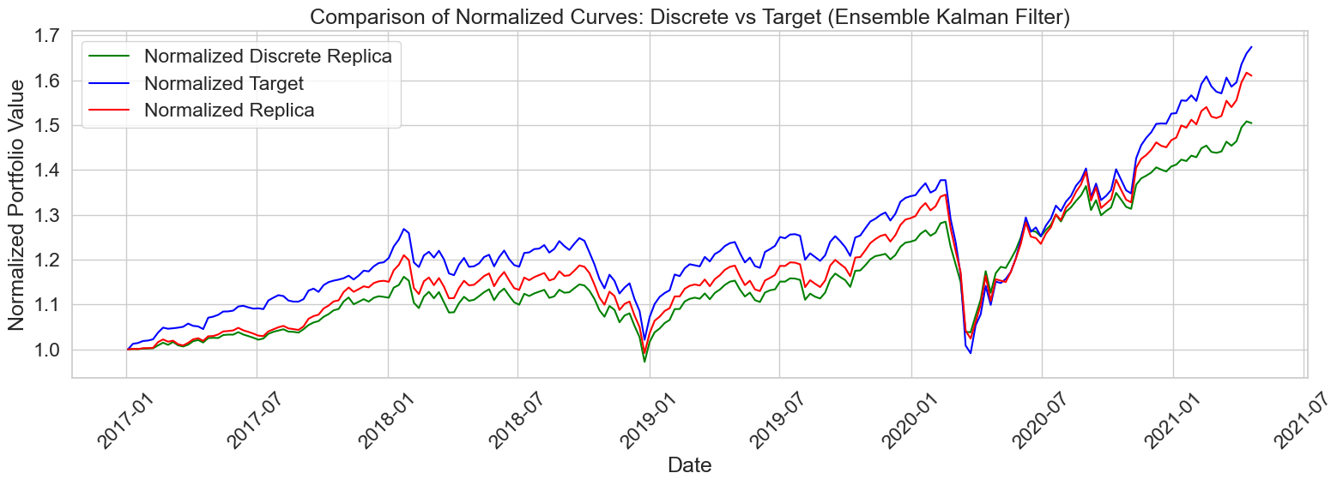
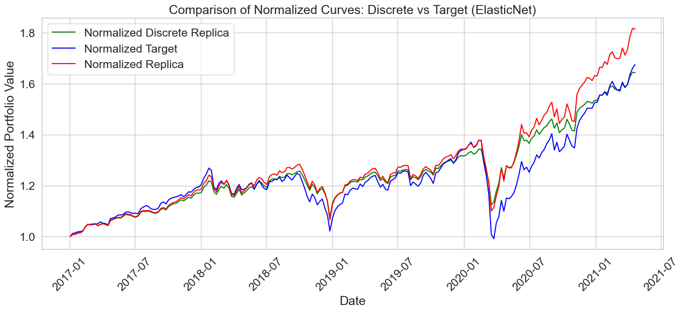
DISCRETE PORTFOLIO ALLOCATION AND TRANSACTION COST ANALYSIS
The analysis now shifts from continuous portfolio weights to a discrete allocation framework, in which weights are converted into actual positions for a portfolio of fixed value. This representation more accurately mirrors the practical trading and rebalancing constraints of real markets.

Slide 14
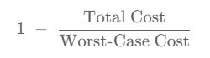
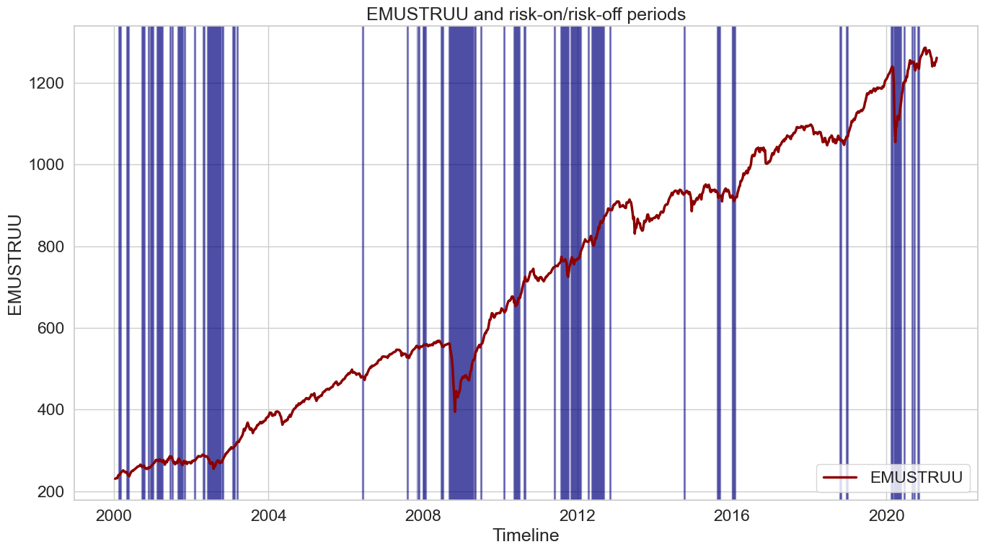
ANOMALY DETECTION
This section examines the identification of anomalies in financial time-series data and assesses their effect on portfolio performance.
The objectives are:
Detect observations that could impair portfolio strategies
Compare the effectiveness of alternative detection techniques.
Financial Score
Cost per error
Misclassifying an anomaly observation (Y = 1) incurs a penalty equal to mean_anomaly.
Misclassifying a normal observation (Y = 0) incurs a penalty equal to mean_normal.
Correct classifications carry no penalty.
Total cost
Sum of all row-level penalties in the test set.
Worst-case cost
Penalty that would result if every prediction were wrong.
A value of 1 denotes perfect classification, whereas 0 represents the worst possible outcome.

Slide 15
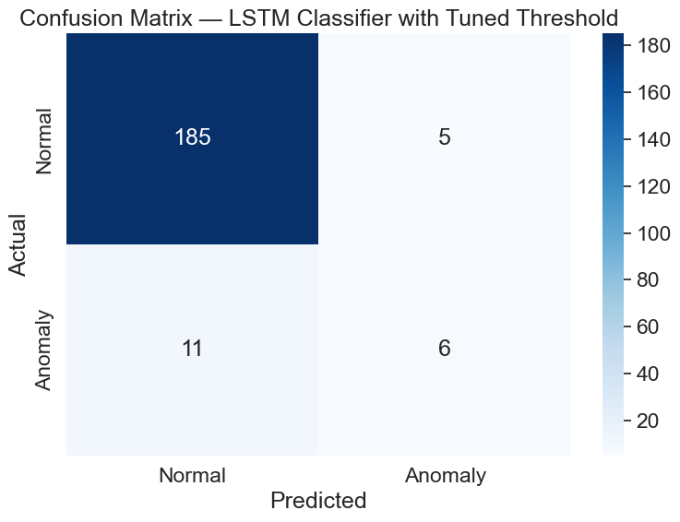
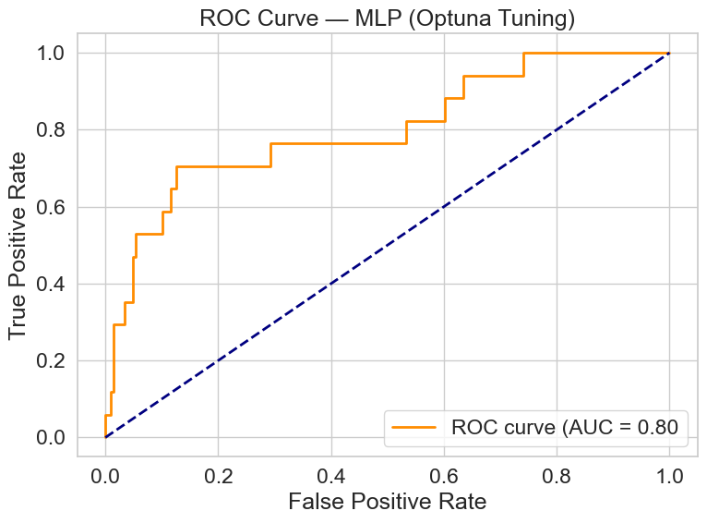
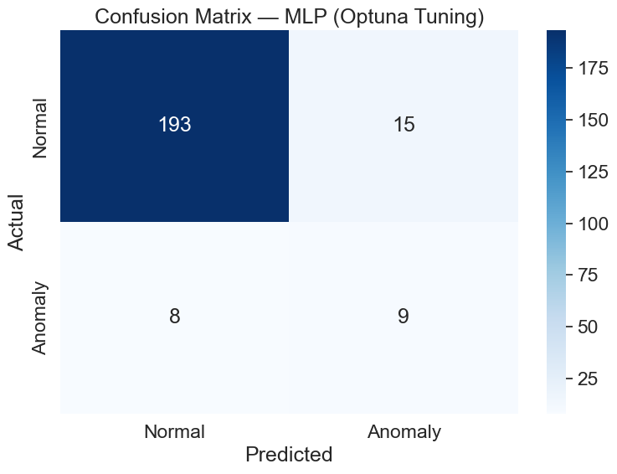
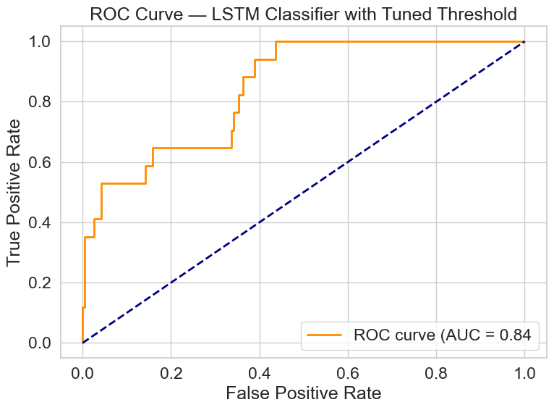
RESULTS
MLP Classifier: Basic architecture: 512 → 256 → 128 → 64 → 32 → 16 neuronsTuned version: layers & hyper-params optimized with Optuna for higher anomaly-detection accuracy
LSTM Autoencoder: (Unsupervised)Learns to reconstruct normal patterns; large reconstruction error ⇒ anomalyArchitecture & anomaly threshold auto-tuned with OptunaTargets structural deviations in multivariate time-seriesC. LSTM Classifier (Supervised)Trains directly on Y-labels (normal vs. anomalous)Two decision thresholds0.50 (standard)Tuned for a user-defined precision target → more conservative alerts

Slide 16
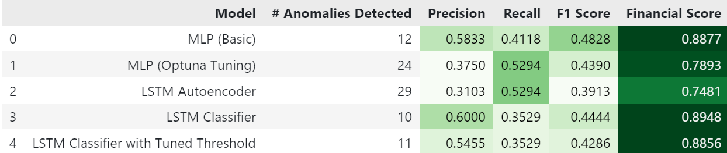
RESULTS
ANOMALY INTEGRATION
Discrete overlay | Real-world tradability | Extra noise & costs
Fractional overlay | Higher risk-adjusted returns; keeps model precision | Requires fractional execution capability

Slide 17
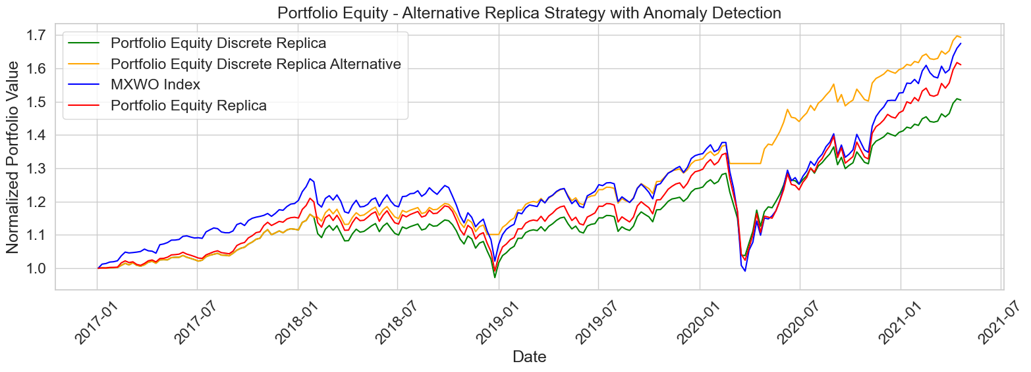
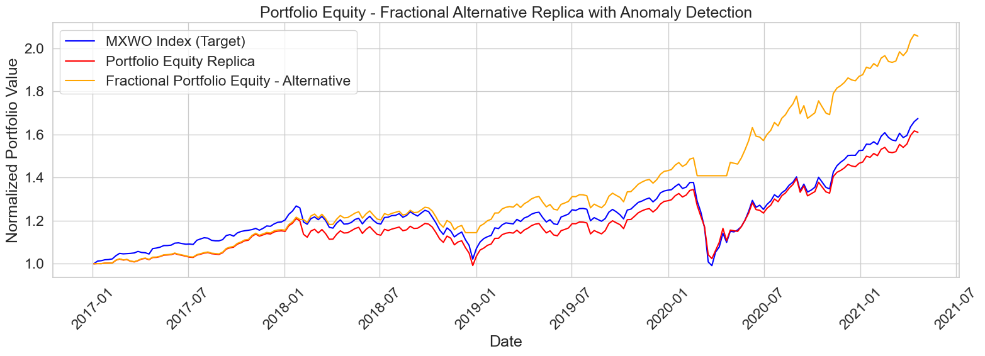
INTEGRATE ANOMALY-DETECTION SIGNALS INTO INDEX-REPLICATION
Load binary anomaly flags generated by the chosen ML model.
If a flag = 1 (stress), set all portfolio weights to 0 → move entirely to cash.
Apply the overlay in two variants:
Discrete allocation – rounded positions for a fixed-value book.
Continuous weights – original fractional weights from the replication model.
4. Re-compute performance and risk metrics for both
variants.
Key Findings
Continuous-weight overlay preserves model precision and delivers the best risk-adjusted results.
Discrete overlay is more realistic but introduces extra implementation noise and transaction costs.

Slide 18



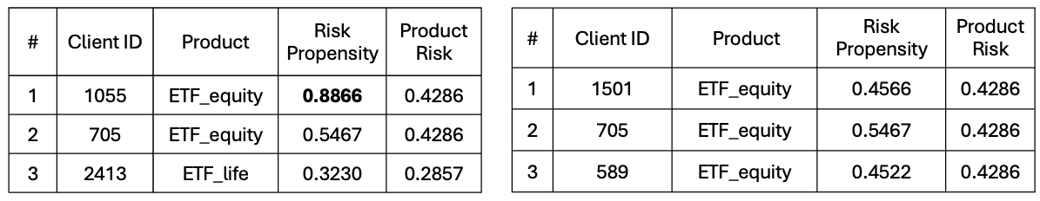
RECOMMENDATION (NBA ALGORITHM)
The classified customer profiles were linked to the portfolio options to create a personalized investment recommender.
Given a new customer’s segment, the system suggests one of the six portfolios (or a blend), aiming to match the investor’s risk-return needs. The recommender was tested on a hold-out set, measuring how often its recommendations align with a reference (simulated) “optimal” choice.
Evidence in the test set show that our model can generalize beyond the training sample. In practice, this means the approach could realistically support portfolio selection in a wealth-management context, offering personalized allocations that resonate with each investor’s profile.

Slide 19
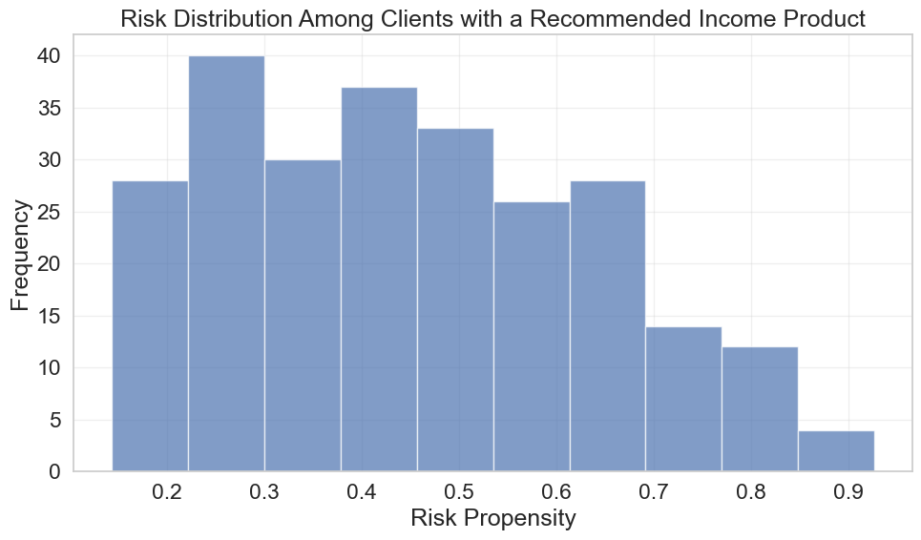
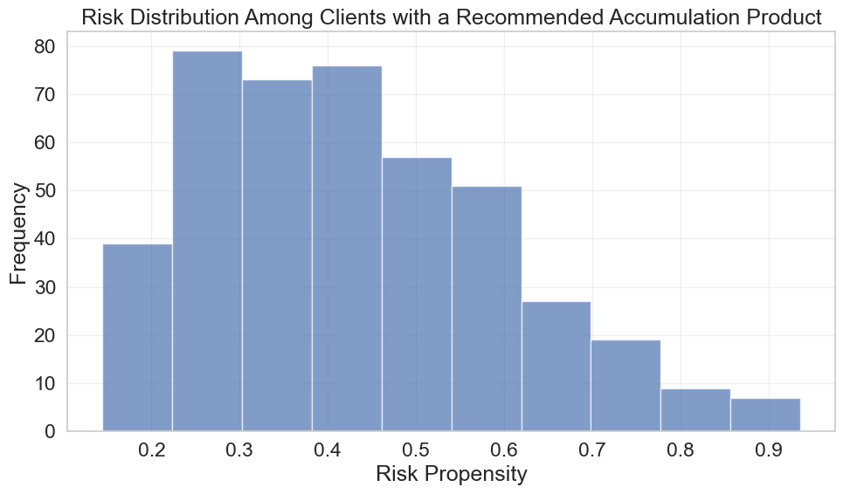
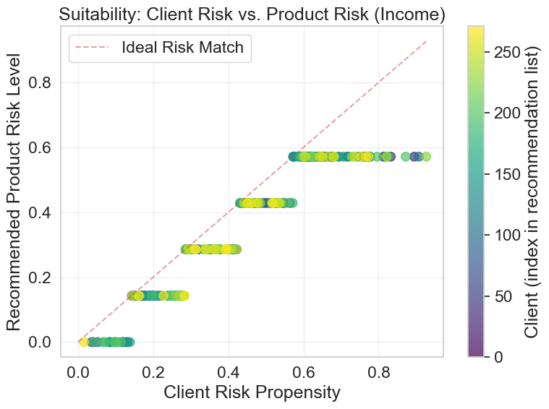
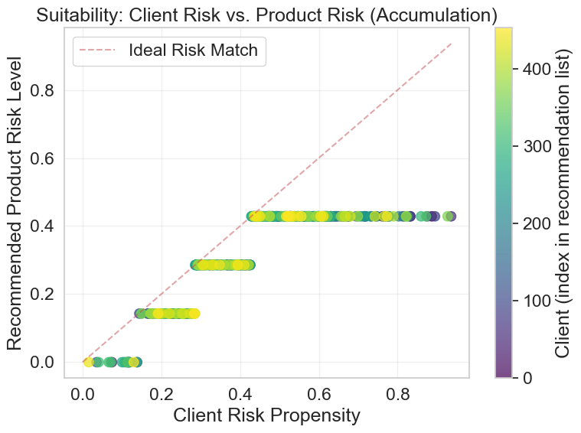

Slide 20


VISIT OUR WEB APP
Find it at:
https://gm46.pythonanywhere.com/
To tie our work together we decided to develop a WebApp which gives a great idea of real world applications and possible development of our work.

